Slide 1

Base Reuse Plan
Post-Reassessment
“Category I” BRP corrections and next steps
Fort Ord Reuse Authority
March15, 2013

Slide 2
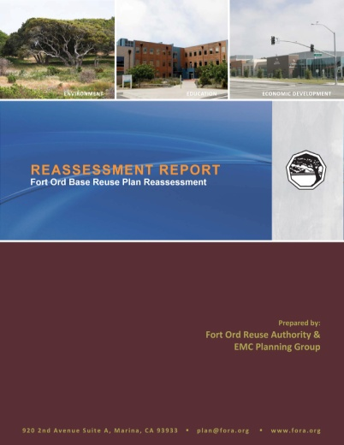
2012 Reassessment Report
  Policy topics/options:
  Category I BRP Modifications & Corrections
  (i.e., typos, outdated references, minor clarifications)
  Discussed at Post-Reassessment Workshop #1 - 2/15/2013
  Cat. II Prior Board Actions & Regional Plan Consistency
  Cat. III Implementation of BRP Policies & Programs
  Cat. IV BRP Policy & Program Modifications
  Cat. V FORA Procedures & Operations

Slide 3
Category I
Corrections to 1997 BRP text and figures
Non-substantive corrections: Typos, outdated references, clarifications
  Representative examples:
    Typo: “TheCity The City of Marina shall…”
    Outdated Reference: “The County shall comply with the current version of the General Industrial Storm Water Permit adopted by the SWRCB in November 1991 that requires…”
    Clarification: “The City shall require that the recipients of land recipients of properties within the former Fort Ord implement the Fort Ord HMP.”
Final Reassessment Report, pages 3-3 to 3-19
  Summary table and full text (strikethrough and underline, with brief explanations where warranted), presented in context for each text change
  Previously coordinated with jurisdictional staff (Admin Comm.)
  Publicly circulated beginning with draft Reassessment Report (Oct. 2012), finalized in Dec. 2012
  Board Report attachment taken directly from the Reassessment Report

Slide 4
Category I (cont’d)
Staff recommendation: Approve these previously identified, non-substantive “Cat. I” BRP corrections.
The Cat. I corrections will be kept on file and included in a future BRP publication.
  Publication schedule, full scope, and budget to be determined, subsequent to completion of post-reassessment workshops and further Board review.

Slide 5
Next Steps
Policy topics/options regarding potential substantive BRP changes will be addressed in the ongoing workshops.
  Workshop #2: Friday, March 22 (2:00 to 5:00 PM)
  See attached proposed agenda
  Detailed report and attachments will circulate on Monday, March 18.

Slide 6
Proposed, revised three-workshop schedule outline
  Policy topics/options:
  Category I BRP Modifications & Corrections
  (i.e., typos, outdated references, minor clarifications)
  Cat. II Prior Board Actions & Regional Plan Consistency
  Cat. II Prior Board Actions & Regional Plan Consistency (cont’d)
  Recommendation: Each Cat. II subtask,1-4, to return as a separate agendized item for Board action (Target: May-Aug. 2013)
  Cat. III Implementation of BRP Policies & Programs
  Rec.: Direct Admin Committee and FORA staff to develop a work plan for Board review (Target: July-Aug. 2013)
  Cat. IV BRP Policy & Program Modifications (intro)
  Rec.: Board Chair appoint an advisory committee to form Cat. IV priority recommendations for full Board’s consideration at Workshop #3
  Cat. IV BRP Policy & Program Modifications (follow-up)
  Cat. V FORA Procedures & Operations
Previous Workshop 1
(Feb. 15)
Workshop 2
(Mar. 22)
Workshop 3
(Apr. 19)
Recommendation: Postpone Workshop #3 to allow time for a Cat. IV advisory committee to develop priority recommendations.
Proposed new date: Friday, May 17.

Slide 7
Questions

